Slide 1
Human Computer Interation

Slide 2
Course Description
Objectives: The designer of interactive computer systems create a language or dialogue that allows users to communicate with their systems. This language may take many forms, such as a text-based command-line interface, a graphical user interface with windows and buttons, a 3D graphical visualization, or an interface with electrical, visual, and mechanical elements.

Slide 3
Course Description
Objectives: In this course you will learn how to design, implement, and evaluate different types of user-interfaces. The course (~twenty two lectures) provides an introduction to Human-Computer Interaction (HCI). HCI is concerned with understanding, designing, implementing and evaluating user-interfaces so that they better support users in carrying out their tasks. On completing the course you will have a knowledge of the theoretical foundations of designing for interaction between humans and computers. You will also have practical experience in implementing and evaluating graphical user interfaces.
A. Acan Human Computer Introduction, CMSE323, Introduction

Slide 4
Course Description
Learning outcomes:
1. Explain fundamental concepts in HCI;
2. Carry out a range of different types of user studies and usability studies;
3. Produce different types of interface prototypes;
4. Explain the entire design lifecycle, and implement a complete user-centered design process including user studies, prototyping, and evaluation;
A. Acan Human Computer Introduction, CMSE323, Introduction

Slide 5
Course Description
Learning outcomes:
5. Critically assess different methods and approaches in HCI; and be able to provide such critique in applied settings;
6. Describe implementation, and justify approach to, user-centered design processes for a range of real-world scenarios.
A. Acan Human Computer Introduction, CMSE323, Introduction

Slide 6
Course Description
Learning outcomes:
7. Be able to apply models from cognitive psychology to predicting user performance in various human-computer interaction tasks and recognize the limits of human performance as they apply to computer operation
8. Working in small groups on a product design from start to finish will provide you with invaluable team-work experience.
A. Acan Human Computer Introduction, CMSE323, Introduction

Slide 7
Human-Computer Interaction (HCI)
Human
  the end-user of a program
  the others in the organization
Computer
  the machine the program runs on
Interaction
  the user tells the computer what they want
  the computer communicates results
The System
Input
Output
The User
A. Acan Human Computer Introduction, CMSE323, Introduction

Slide 8

The Human
A. Acan Human Computer Introduction, CMSE323, Introduction

Slide 9
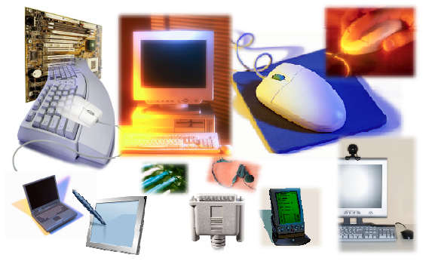
The Computer
A. Acan Human Computer Introduction, CMSE323, Introduction

Slide 10
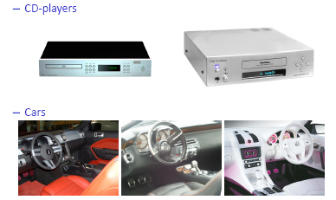
The Interaction
A. Acan Human Computer Introduction, CMSE323, Introduction

Slide 11
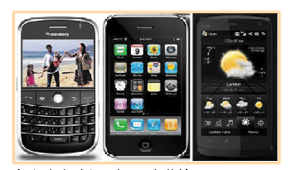
The Interaction
A. Acan Human Computer Introduction, CMSE323, Introduction

Slide 12
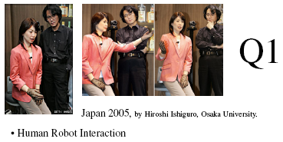
The Interaction
A. Acan Human Computer Introduction, CMSE323, Introduction

Slide 13
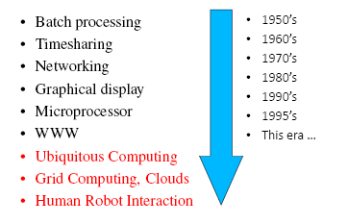
Interaction Paradigms
A. Acan Human Computer Introduction, CMSE323, Introduction

Slide 14
Introduction
Human Computer Interaction (HCI) is the study of how people interact with computers and to what extend people-computer interaction influence each other.
The design, development and evaluation of models, systems, techniques and applications from a human-centered perspective
As its name implies, HCI consists of three components: the users, the computers, and the ways they work together.
Studies of HCI originated from discussions concerning “human factors” in design during the world war II.
“BADLY DESIGNED WEAPONS CAN KILL YOUR OWN FORCES INSTEAD OF THE ENEMY”
A. Acan Human Computer Introduction, CMSE323, Introduction

Slide 15
Why HCI is Important
It is the study of our interface with information.
It is not just ‘how big should I make buttons’ or ‘how to layout menu choices’
It can affect
  Effectiveness
  Productivity
  Morale
  Safety
Example: a car with poor HCI
A. Acan Human Computer Introduction, CMSE323, Introduction

Slide 16
Why HCI is Important
“Human-computer interaction is the kind of discipline which is neither the study of humans, nor the study of technology, but rather the bridging between those two. So you always have to have one eye open to the question: what can the technology do? How can you build it? What are the possibilities? And one eye open to the question: what are people doing and how would this fit in? What would they do with it? If you lose sight of either of those, you fail to design well.” [Prof. Terry Winograd, Stanford University]
A. Acan Human Computer Introduction, CMSE323, Introduction

Slide 17
Why Study User Interface Design?
  75% or more of development effort can go into the user interface
    40% to 70% is typical
    User interface specialists are needed
    Everybody needs to know the basics
  User interface software is becoming more complex
    Complexity increase is faster than other aspects of systems
    Graphical user interfaces have provided the biggest jump in complexity
    Applications tend to grow to fill available computing resources
  There are direct financial benefits from improved user interfaces
A. Acan Human Computer Introduction, CMSE323, Introduction

Slide 18
Concerns in HCI
Science, Engineering, and Design Aspects
the joint performance of tasks by humans and machines
the structure of communication between human and machine
human capabilities to use machines (including the learnability of interfaces)
algorithms and programming of the interface itself
engineering concerns that arise in designing and building interfaces
the process of specification, design, and implementation of interfaces
design trade-offs
A. Acan Human Computer Introduction, CMSE323, Introduction

Slide 19
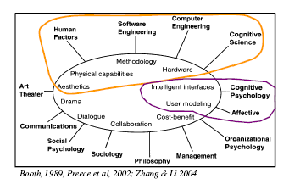
Multi-Disciplinarity in HCI
A. Acan Human Computer Introduction, CMSE323, Introduction

Slide 20
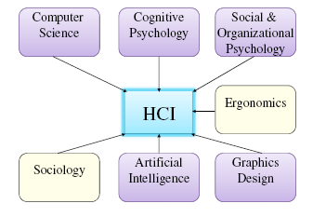
Disciplines Contributing to HCI
A. Acan Human Computer Introduction, CMSE323, Introduction

Slide 21
Typical Topics in HCI
Human cognition
perception; visual/auditory cognition; ecological interfaces; motion cognition; memory and attention; meaning and representation; learning; language understanding; mental models and metaphors
Designing for collaboration & communication
information visualization; online communities; dialog models; presentation styles; group dynamics; groupware and discussion-ware
A. Acan Human Computer Introduction, CMSE323, Introduction

Slide 22
Typical Topics in HCI (Cont.)
Understanding how interfaces/technology affect users
ergonomics; safety-critical systems; work environments; social and behavioral impact (individual and group); diversity and the digital divide
User-centered approaches to interaction design
identify needs and establish requirements; integrate users into design, prototyping and construction phases
A. Acan Human Computer Introduction, CMSE323, Introduction

Slide 23
Typical Topics in HCI (Cont.)
Usability evaluation
observing users; testing and modeling users; expert evaluations
Interaction styles
direct manipulation; virtual environments; menus and forms; commands and natural language; hands-free input; heads-up displays
Interaction devices
keyboard, pointing devices, speech I/O, image and video I/O, other sensory devices, mobile devices
A. Acan Human Computer Introduction, CMSE323, Introduction

Slide 24
What’s the Problem?
“To be a good programmer, one must be sympathetic to the nature and needs of the computer
But the nature and needs of the computer are utterly alien to the nature and needs of the human being who will eventually use it.”
“In the programmer’s mind, the demands of the programming process not only supercede any demands from the outside world of users, but the very languages of the two worlds are at odds with each other.”
A. Acan Human Computer Introduction, CMSE323, Introduction

Slide 25
What’s the Problem?
“When the creators of software-based products examine their handiwork, they overlook how bad it is.
Instead, they see its awesome power and flexibility. They see how rich the product is in features and functions.
They ignore how excruciatingly difficult it is to use, how many mind-numbing hours it takes to learn, or how it diminishes and degrades the people who must use it in their everyday lives.”
A. Acan Human Computer Introduction, CMSE323, Introduction

Slide 26
What’s the Problem?
“Programmers aren’t evil. They work hard to make their software easy to use.
Unfortunately, their frame of reference is themselves, so they only make it easy to use for other software engineers, not for normal human beings.
A. Acan Human Computer Introduction, CMSE323, Introduction

Slide 27

Example 1
A. Acan Human Computer Introduction, CMSE323, Introduction

Slide 28
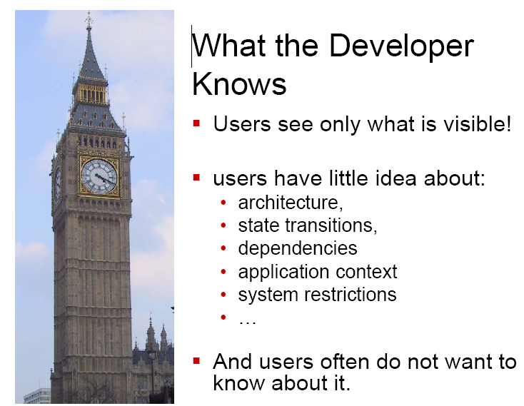
Example 1
A. Acan Human Computer Introduction, CMSE323, Introduction

Slide 29
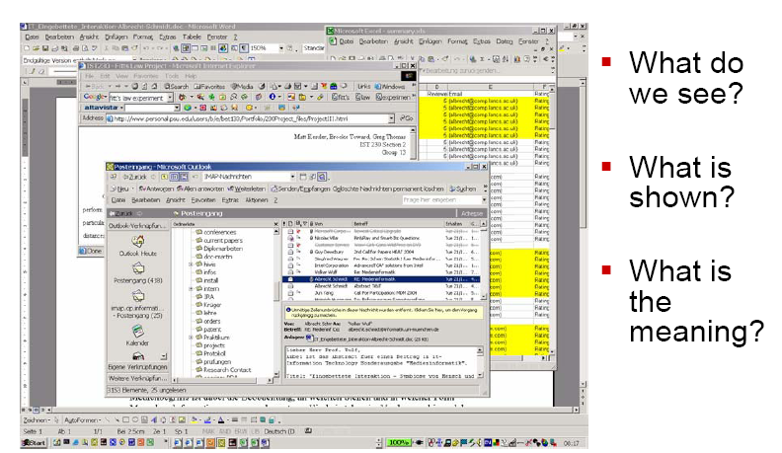
Example 2
A. Acan Human Computer Introduction, CMSE323, Introduction

Slide 30
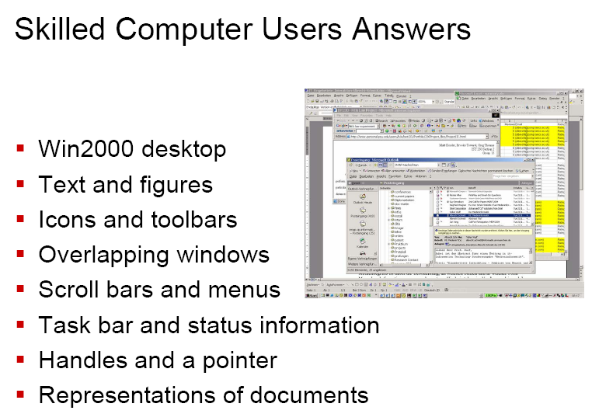
Example 2
A. Acan Human Computer Introduction, CMSE323, Introduction

Slide 31
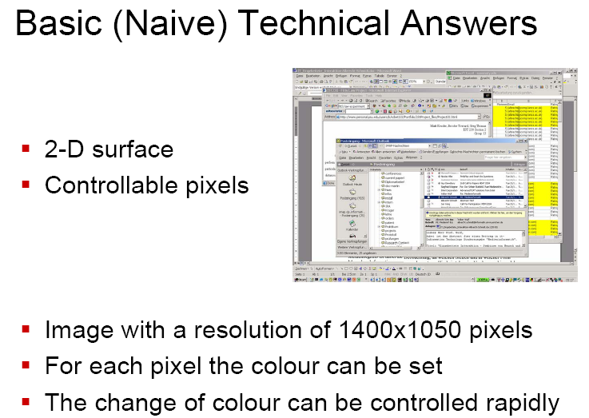
Example 2
A. Acan Human Computer Introduction, CMSE323, Introduction

Slide 32
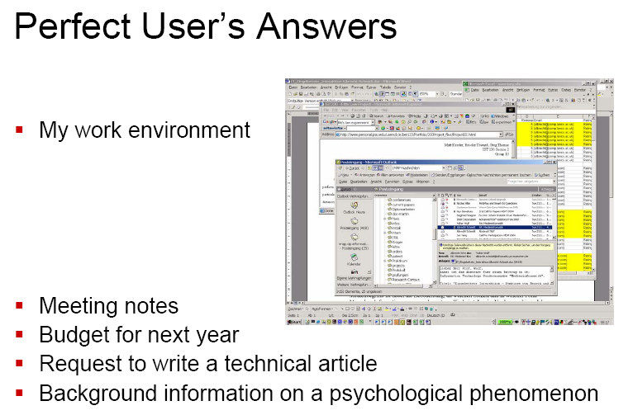
Example 2
A. Acan Human Computer Introduction, CMSE323, Introduction

Slide 33
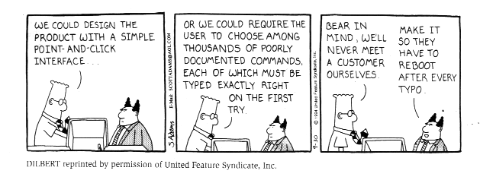
A successful (intelligent) product is more than the development of and the knowledge about the latest technology
What other parts contribute to a well designed product?
A. Acan Human Computer Introduction, CMSE323, Introduction
Notes:
Two common reasons when a project fails are:
the lack of user input during the design and development process
And
2. The lack of requirements that the final product should meet in the end.

Slide 34
Effective user interfaces mean:
More accurate diagnoses for doctors
Safe flying for pilots and passangers
More effective learning for children
More productive lives for people with disabilities
More creativity for artists
However, badly designed interfaces with
Excessively complex menus
Incomprehensible terminology
Chaotic navigation paths
cause frustration, fear, and failure.
A. Acan Human Computer Introduction, CMSE323, Introduction

Slide 35
Technology-driven vs user-centred design
The technology runs the design of the interface which give the user the functionality of the system
Users put demands on the functionality of the interface which runs the design of the technology
A. Acan Human Computer Introduction, CMSE323, Introduction

Slide 36
Usability
Key concept in HCI
Can be broken down into the following goals:
  Effective to use (effectiveness)
  Efficient to use (efficiency)
  Safe to use (safety)
  Have good utility (utility)
  Easy to learn (learnability)
  Easy to remember how to use (memorability)
A. Acan Human Computer Introduction, CMSE323, Introduction
Notes:
Preece, Rogers and Sharp page 14
A central concern is to develop interactive products that are usable. This means they should for example be easy to learn and effective to use.
Usability is a key concept in HCI and it can be broken down into the following goals:

Slide 37
Usability
These goals are achieved by thoughtful planning, sensitivity to user needs, devotion to requirements analysis, and diligent testing, all while keeping budget and on schedule.
The following usability goals aims to achieve effectiveness, efficiency, and satisfaction:
A. Acan Human Computer Introduction, CMSE323, Introduction

Slide 38
Usability
1. Time to learn: how long does it take for a typical user to learn how to use the actions relevant to a set of tasks?
2. Speed of performance: how long does it take to carry out the benchmark tasks?
3. Rate of errors by users: how many and what kind of errors do people make in carrying out the benchmark tasks? Error handling is a critical component of interface design.
A. Acan Human Computer Introduction, CMSE323, Introduction

Slide 39
Usability
4. Retention over time: how well do users maintain their knowledge after an hour, a day, or a week?
5. Subjective satisfaction: how much did users like using various aspects of interface?
A. Acan Human Computer Introduction, CMSE323, Introduction

Slide 40
Usability
Every designer would like to succeed in every measure, but there are often forced tradeoffs.
If lengthy learning is permitted, task-performance times may be reduced by use of complex abbreviations and shortcuts.
If the error rate is to be kept extremely low, speed of performance may have to be sacrificed.
There is always a trade-off among subjective satifaction, short learning times, and rapid performance.
A. Acan Human Computer Introduction, CMSE323, Introduction

Slide 41
Usability
Interface usability is partcularly important in the following fields:
- Life-critical systems: air traffic, nuclear reactors, power utilities, police and fire department, military operations, and medical instruments.
    - lengthy training periods are acceptable to obtain rapid and error-free performance, even when users are under stress.
A. Acan Human Computer Introduction, CMSE323, Introduction

Slide 42
Usability
  Industrial and commercial uses: interfaces for banking, insurance, order-entry, prodcution management, airline and hotel reservations.
    - operator training times is expensive, so ease of learning is important. Subjective satisfaction is of modest importance.
  Home and entertainment applications: personal computing applications, e-mail, search engines, cellphones, digital cameras, and music players.
    - balancing between novice and expert users’ desires is difficult.
A. Acan Human Computer Introduction, CMSE323, Introduction

Slide 43
Usability
Exploratory, creative, and collaborative interfaces: www browsers, scientific, business team collaborations, architectural design environments, music composition tools, and video editing systems.
  - two or more people work together, they use text, voice, and video mail through electronic meeting systems. It is difficult to design and evaluate these systems. Users can keep their focus on task, with mininal distraction caused by operating interface.
A. Acan Human Computer Introduction, CMSE323, Introduction

Slide 44
User experience
Interaction design is also concerned with creating systems that are:
  Satisfying
  Enjoyable
  Fun
  Entertaining
  Helpful
  Motivating
  Aesthetically pleasing
  Supportive of creativity
  Rewarding
  Emotionally fulfilling
A. Acan Human Computer Introduction, CMSE323, Introduction
Notes:
Interesting to mention these goals too, since they give you a sense of what other goals and requirements a product might have.

Slide 45
Design principles
Know your user
Reduce cognitive load
Engineer for errors
Maintain consistency and clarity
A. Acan Human Computer Introduction, CMSE323, Introduction
Notes:
These are a few basic but very important principles for HCI design. I will go through all four and give you some more information.
Know your user:
This can be hard when your user group is very general. Knowing your user means many things.
For example: knowing the user is to be aware of different users needs such as providing program shortcuts for knowledgeable users or allowing users to perform a task in more than one way.
Cognitive load:
This concerns designing so that users don’t have to remember large amounts of detail.
Errors:
People will always make errors and also have to make errors in order to learn. Engineering for errors includes forcing a user to prevent him or her from making an error - or at least make it more difficult.
Consistency:
You can maintain consistency by using standard operations and representations and from using appropriate metaphors that help to build and maintain a user’s mental model of the system.

Slide 46
Know your user
Cognitive and perception psychology
  General knowledge about humans
User analysis
  Specific knowledge about a group
Reasons:
  Minimize cognitive load
  Use resources efficiently (system and user)
A. Acan Human Computer Introduction, CMSE323, Introduction
Notes:
cognitive and perception psychology give you general knowledge about humans. A very simple example is that a part of us are colour blind. This means that you shouldn’t build a design where critical information is encoded in red and green colours.
A user analysis gives you valuable information about the specific user group. Are they beginners or experts? Are you designing for teenagers or for old people?
Two important reasons is to minimize the users’ cognitive load, which is has its own design principle.

Slide 47
Reduce cognitive load
Make functions, objects and information visible
  The human brain is limited in its capacity: memory, attention
  E.g. UNIX (cat, grep, mv, lpr) vs GUI (icons); which ones are easiest to recognize/remember?
A. Acan Human Computer Introduction, CMSE323, Introduction
Notes:
Sara will give you a deeper introduction to cognitive and perception psychology.
Visibility might mean that:
Functions should be designed so that they remind the user of what is possible and how to do it
Objects can be designed so that information is “stored” in the design of the object
Information should be presented in a way where its easy to get an overview. Information should also be structured such a way where its easy to navigate
A fundamental finding in memory research is that we recognize things far more easily than we can recall them from memory. This is why its much easier to recognize a file or a function in a menu list or among icons than having to recall a name or a command in e.g. UNIX.

Slide 48
Reduce cognitive load
Provide clear conceptual models
  Help the user getting a clear mental model of the system!
    Metaphors (e.g. the desktop metaphor)
A mental model according to Donald Norman is:
“The model people have of themselves, others, the environment, and the things with which they interact. People form mental models through experience, training and instruction.”
A. Acan Human Computer Introduction, CMSE323, Introduction
Notes:
Donald Norman has provided a definition of mental models:
Basically a mental model help people when they explain and describe something, e.g. a system.
Conceptualizing users’ knowledge in terms of mental models can help designers to develop appropriate user interfaces.
Using metaphors can help the user understanding an device or a system more easily or better.
Interesting!
Ubiquitous computing systems have invisible interfaces, are interconnected and intended to be effortless to use. The ultimate aim of ubiquitous computing is to make the interface metaphor invisible to the user in the same way as computer systems are invisible in home appliances, such as in VCRs or in microwave ovens.

Slide 49
Engineer for errors
Make it difficult for the user to make errors
  E.g. menus give the user the possible alternatives (prevents errors but not mistakes)
Provide good error messages
  Less user frustration
A. Acan Human Computer Introduction, CMSE323, Introduction
Notes:
I mentioned before that you cannot stop people from making errors. However, a good design makes it more difficult.
A crucial thing is to provide the user with feedback. Feedback give the user control and reduces waiting for a result.

Slide 50
Engineer for errors
Reversible actions
  Allow users to correct their own errors
Provide feedback
  The user need to know the state of the system
A. Acan Human Computer Introduction, CMSE323, Introduction

Slide 51
Maintain consistency and clarity
Standard operations and representations
Appropriate metaphors help building and maintaining a user’s mental model
Easier for users to learn, recognize and to foresee what is going to happen
A. Acan Human Computer Introduction, CMSE323, Introduction

Slide 52
HCI has Economic Value ($, €, £)
Think about strong competition on:
Operating Systems
Internet Browsers
Word Processors
Web-editing systems
Photo-editing systems
Commercial database and distributed network applications
A. Acan Human Computer Introduction, CMSE323, Introduction

Slide 53
Financial benefits & Costs of improved user interfaces
  Increased user productivity
    Direct financial savings
  Increased revenues from sales
    The system is more attractive and customer satisfaction is higher
  Decreased training and support costs
    The system is more intuitive
  Decreased maintenance cost
    The system does what user wants
    Much maintenance involves fixing UI problems
    Pay a little during development, or pay a lot after application/product release!
But
  Staff must be trained in user interface analysis and design
  Users must participate
  UI design tools are needed
The benefits almost always outweigh the costs
A. Acan Human Computer Introduction, CMSE323, Introduction

